Slide 1
DSC 640 – Exercise 3.2
Ramsey king

Slide 2
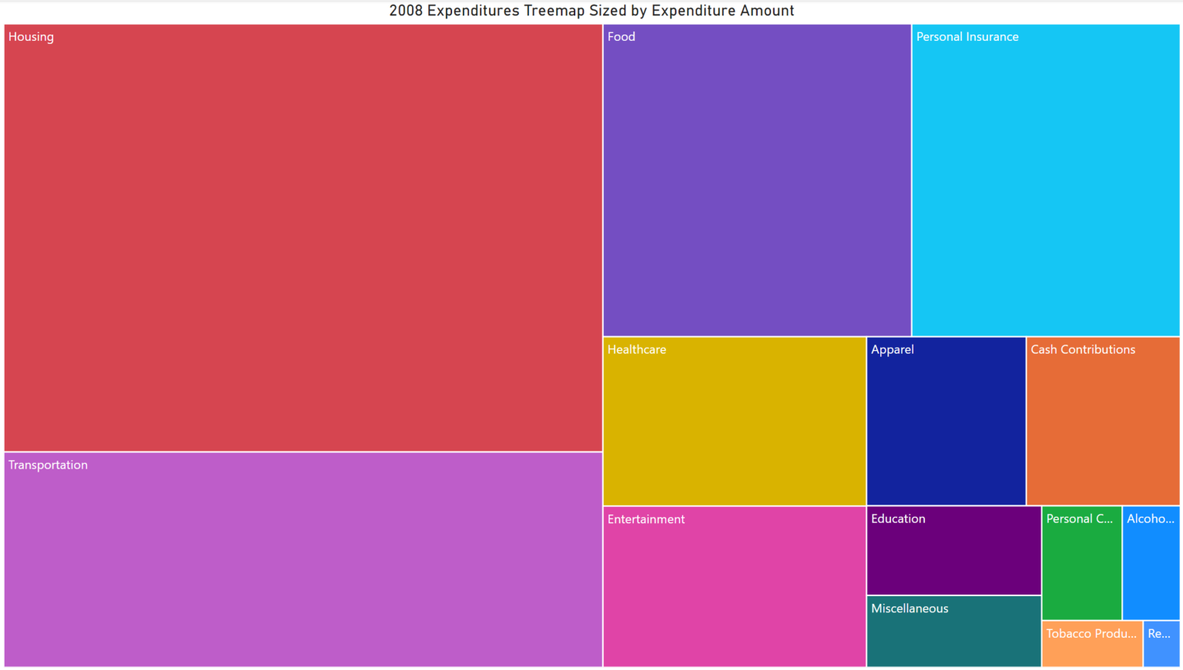
Power bi – treemap

Slide 3
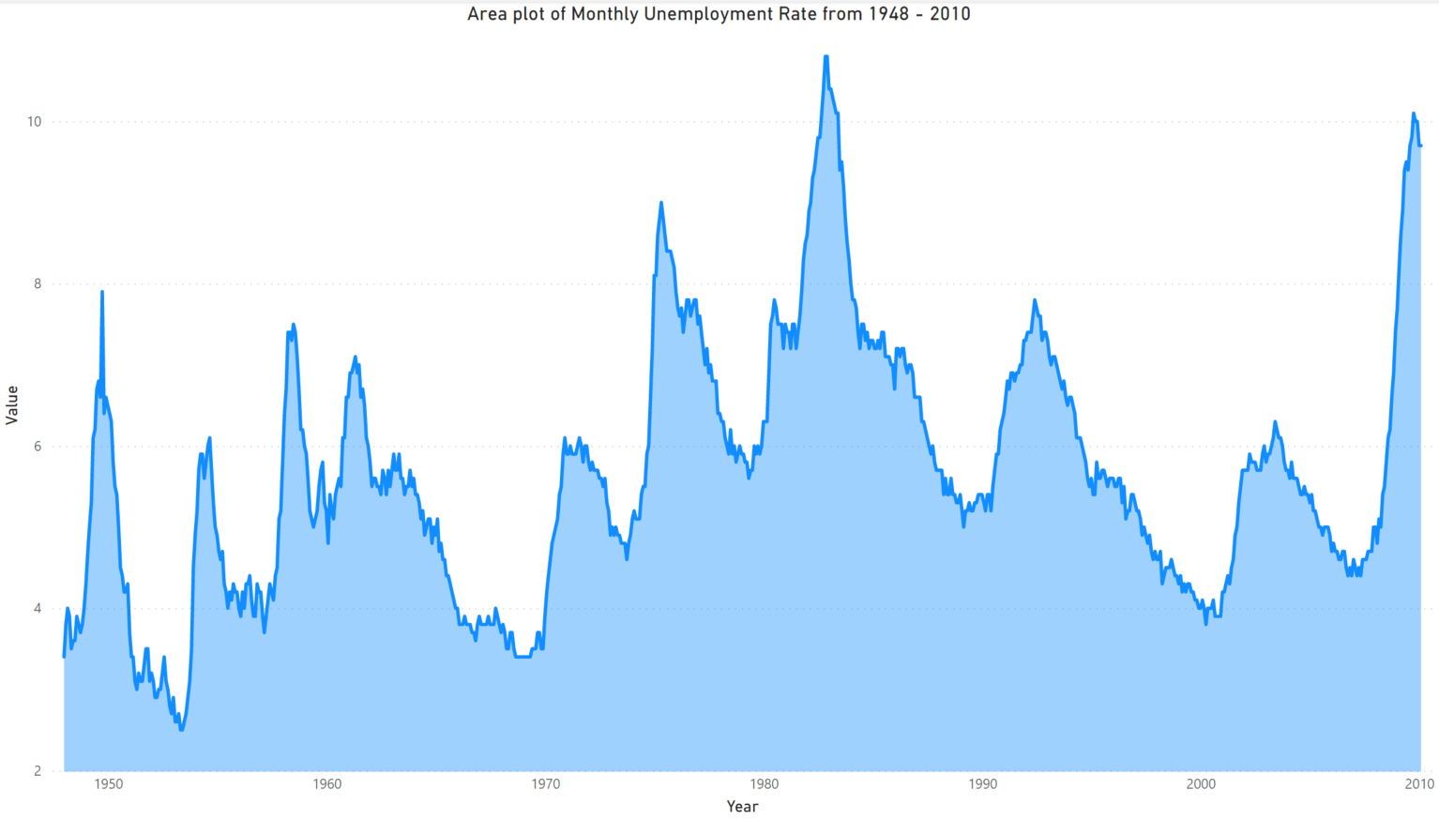
Power bi – area chart

Slide 4
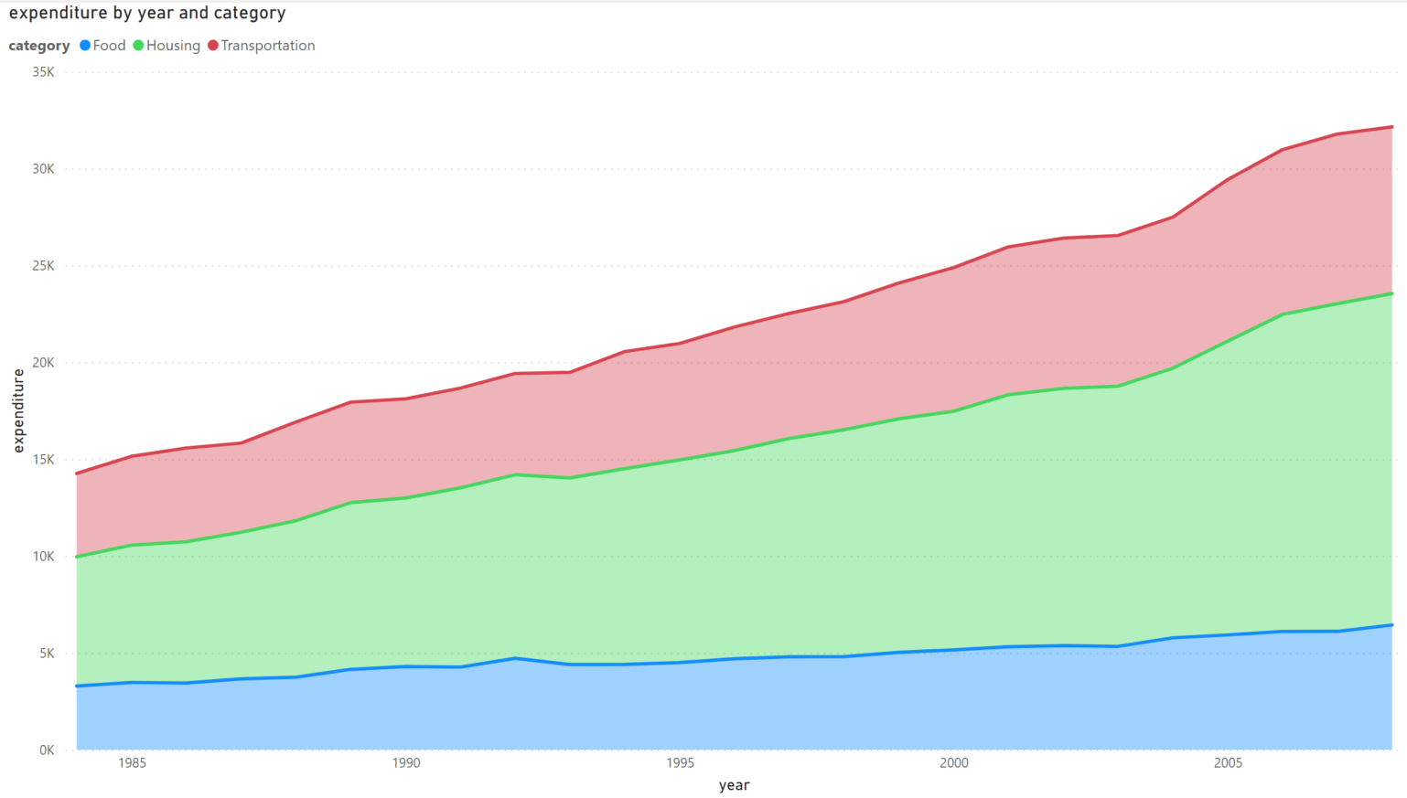
Power bi – stacked area chart

Slide 5
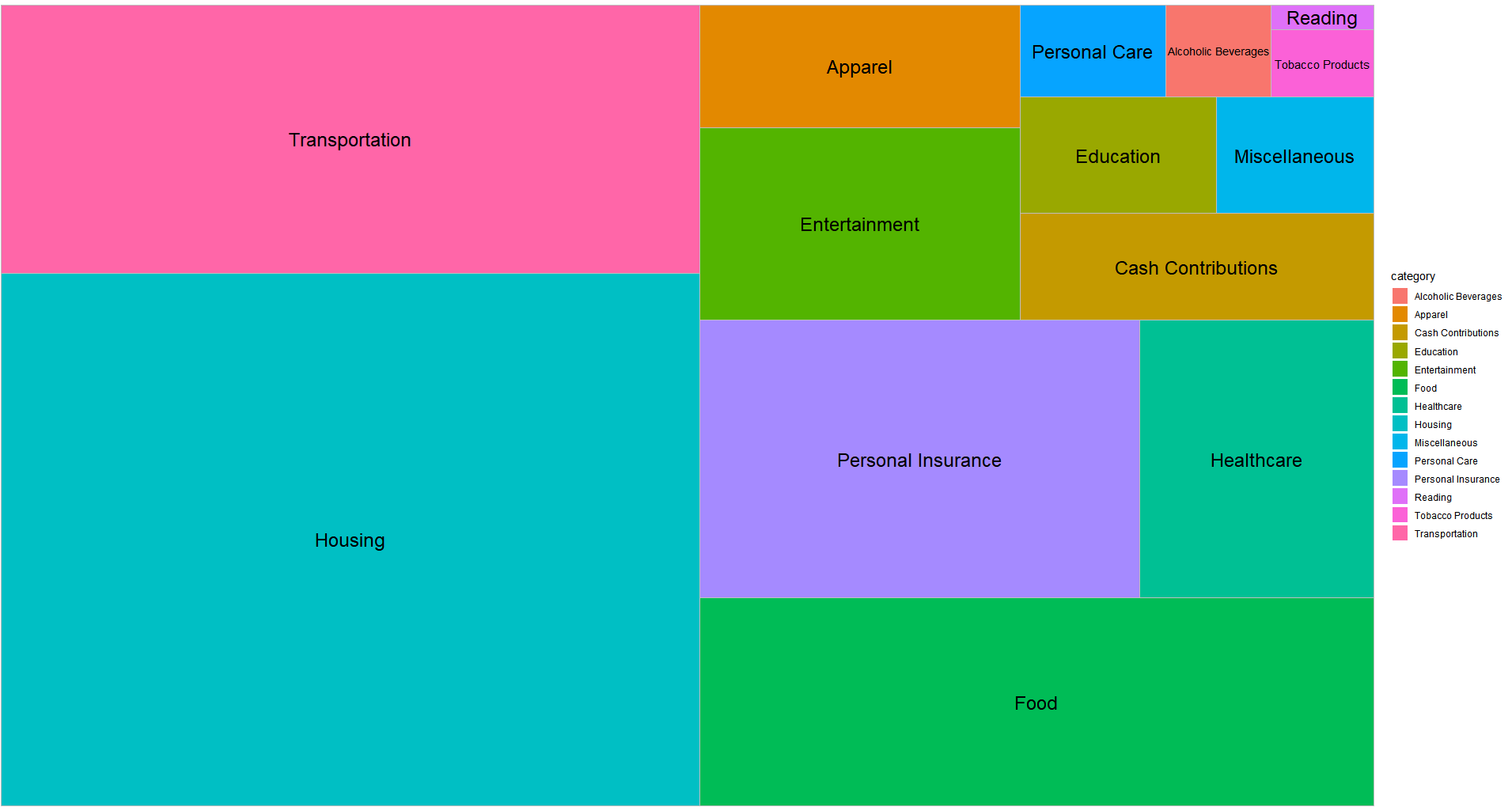
r– treemap

Slide 6
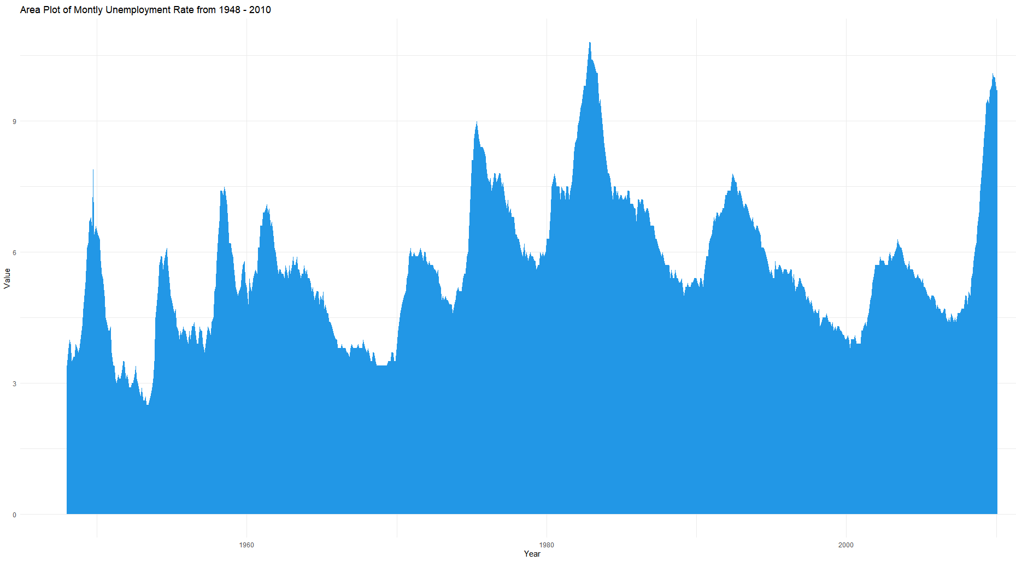
R – area chart

Slide 7
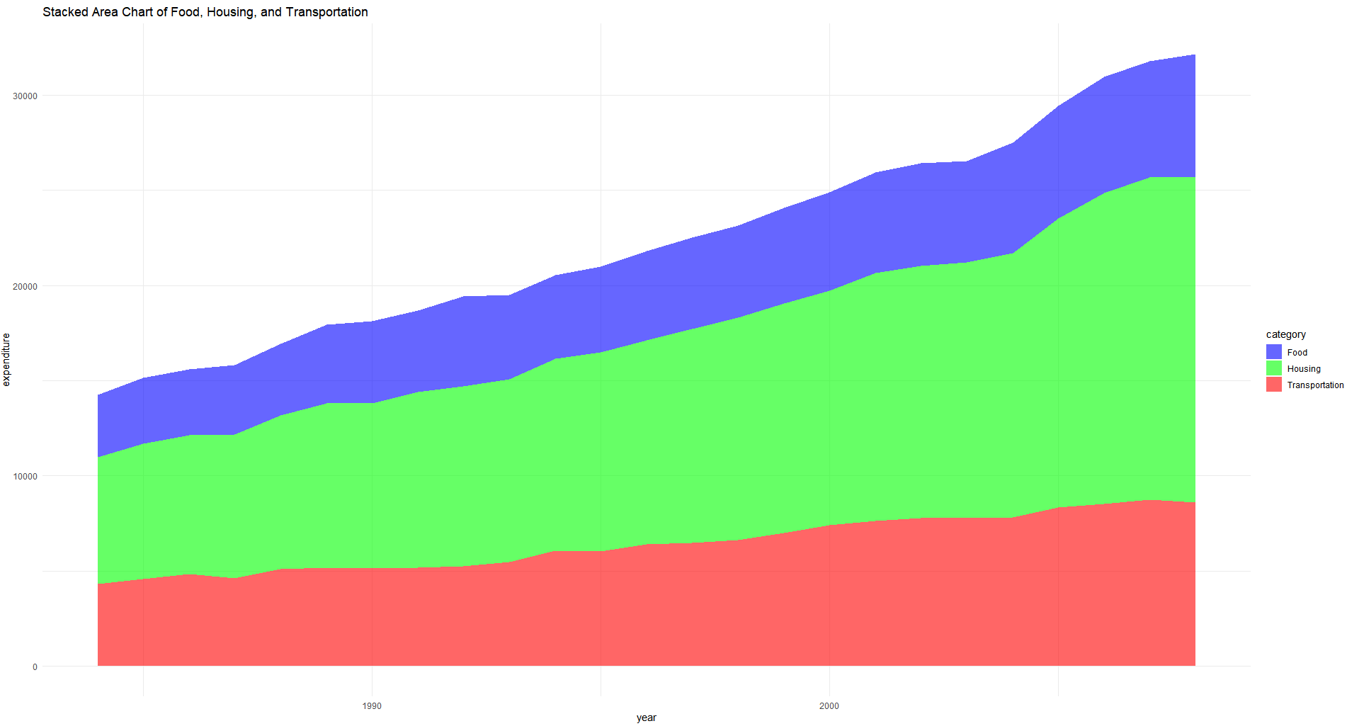
R – stacked area chart

Slide 8
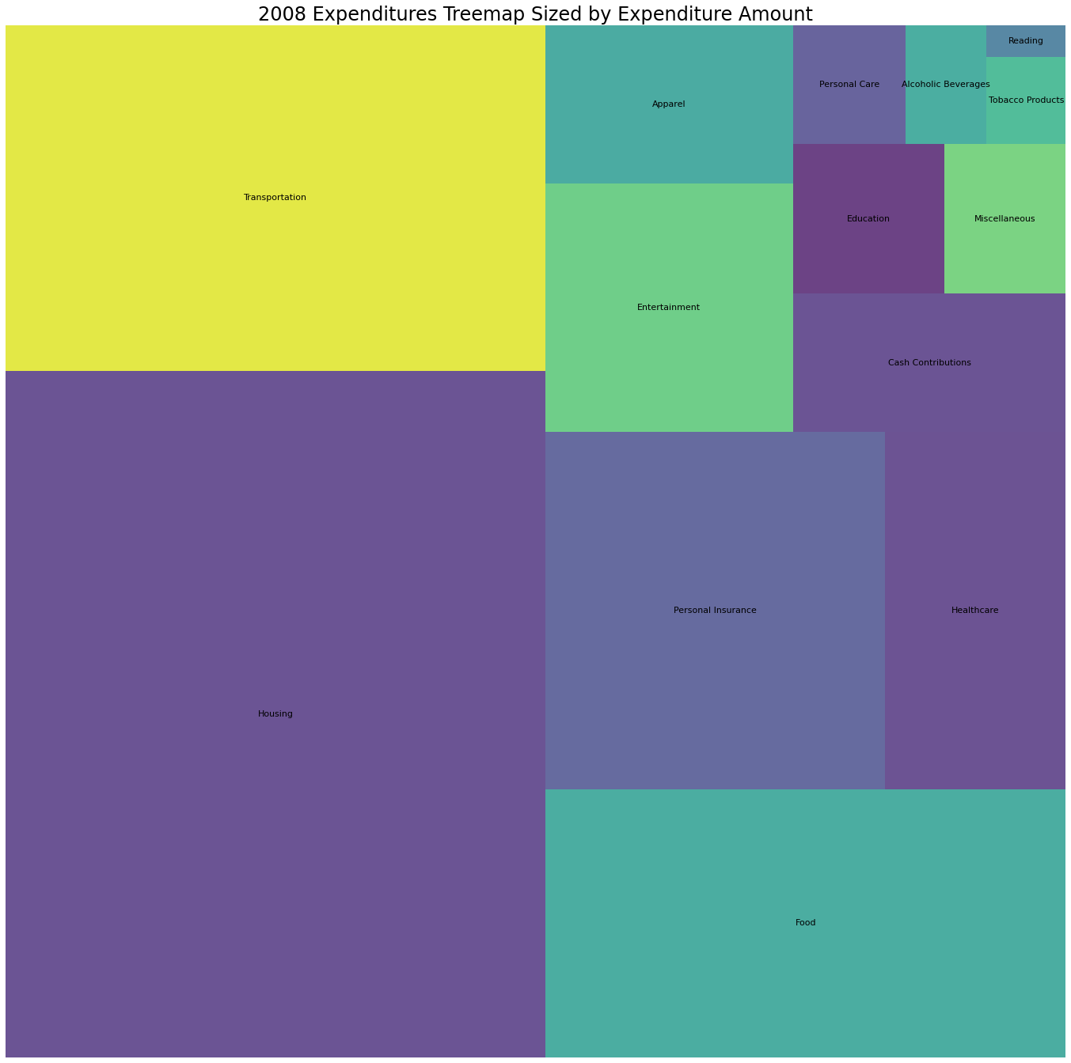
Python – treemap

Slide 9
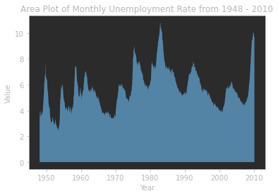
Python – area chart

Slide 10
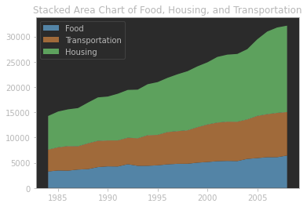
Python – stacked area chart

